Slide 1

Embedded Rust Workshop

Slide 2

Agenda
This part is divided up into:
Introduction
Exploring the Rust embedded ecosystem
Exercise 1
Portable drivers in Rust
Exercise 2

Slide 3

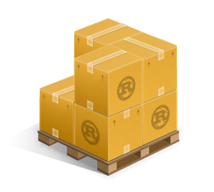



Exploring the Rust embedded ecosystem
Rust, C++, C
core, alloc, std
cargo, crates, rustc
probe-rs

Slide 4
Cortex-m crates
Cortex-m
Peripheral Access Crate
Similar to CMSIS register definitions
Cortex-m-rt
Startup runtime
Interrupt setup

Slide 5
Device PACs
Every device has different peripherals. One PAC for every device.
Generated from SVD
Imported as dependency

Slide 6
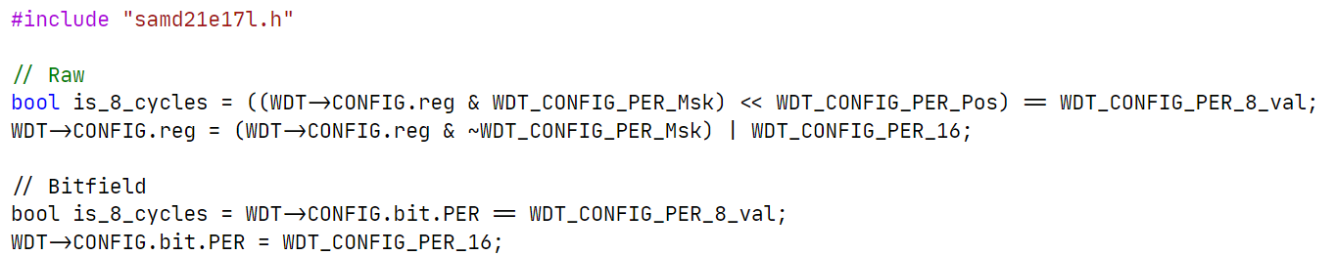
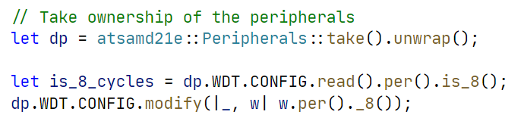
Device PACs
C
Rust

Slide 7
Overview
PAC
SAMD21E
PAC
nRF9160
PAC
nRF52840
PAC
STM32H743
PAC
STM32H753
PAC
STM32L476
PAC
STM32L496

Slide 8
Device HALs
Many open source HALs
Most basic operations supported
Built on top of PACs

Slide 9
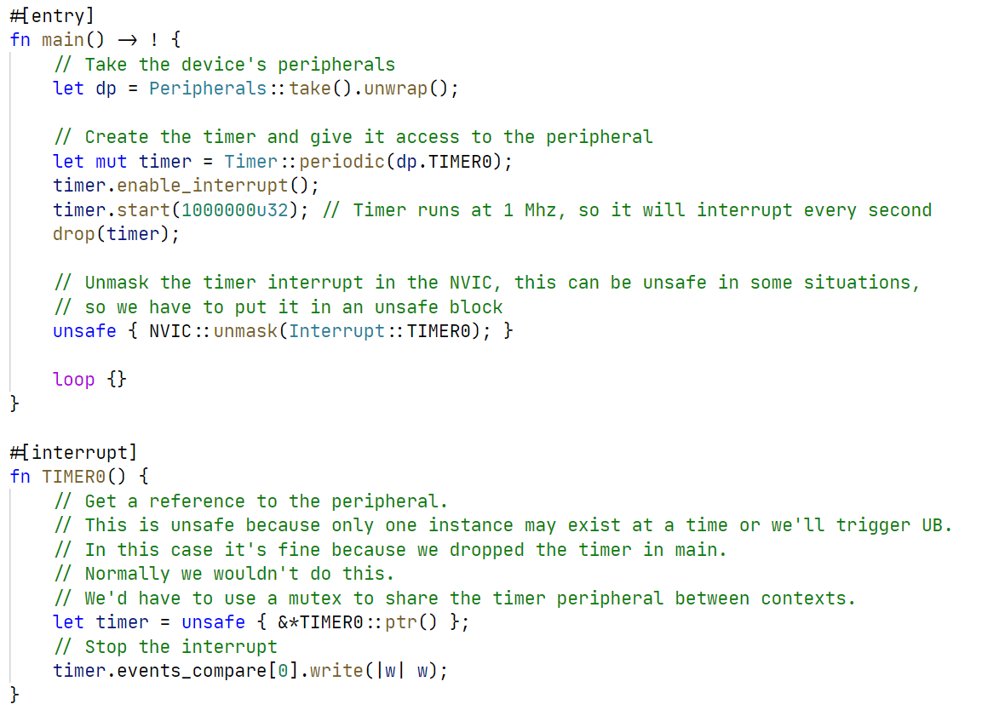
Device HALs

Slide 10
Overview
HAL
atsamd
HAL
nrf-hal
HAL
stm32h7xx-hal
HAL
stm32l4xx-hal
PAC
SAMD21E
PAC
nRF9160
PAC
nRF52840
PAC
STM32H743
PAC
STM32H753
PAC
STM32L476
PAC
STM32L496

Slide 11
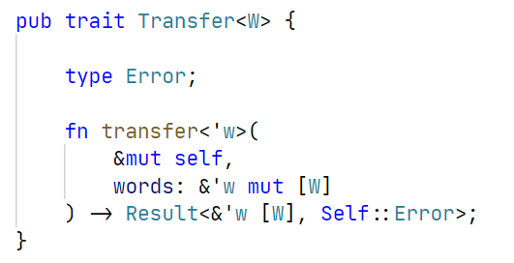
Embedded-hal
The glue of the entire ecosystem
Contains abstractions for many common operations
SPI example trait:

Slide 12
Overview
embedded-hal
HAL
atsamd
HAL
nrf-hal
HAL
stm32h7xx-hal
HAL
stm32l4xx-hal
PAC
SAMD21E
PAC
nRF9160
PAC
nRF52840
PAC
STM32H743
PAC
STM32H753
PAC
STM32L476
PAC
STM32L496

Slide 13
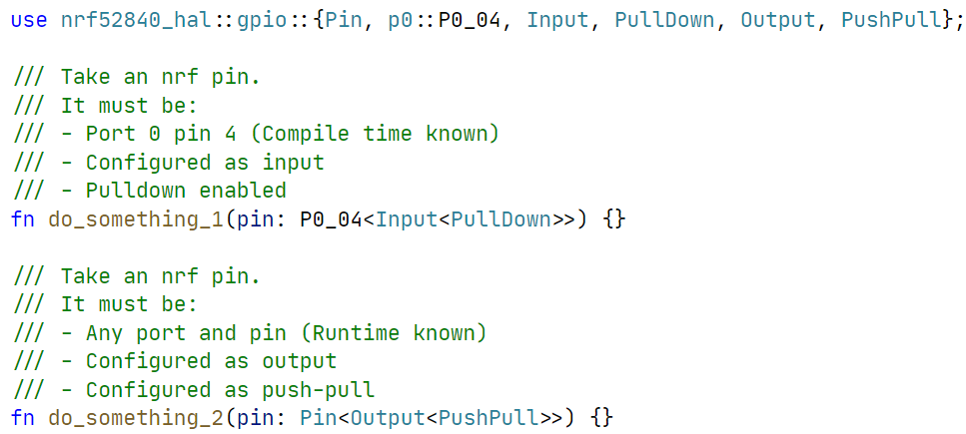
Typestate
State encoded in the type of the variable

Slide 14
Runtimes
Bare metal + interrupts
RTIC
(Real-Time Interrupt-driven Concurrency)
RTOS
Async

Slide 15
Questions so far?
?

Slide 16
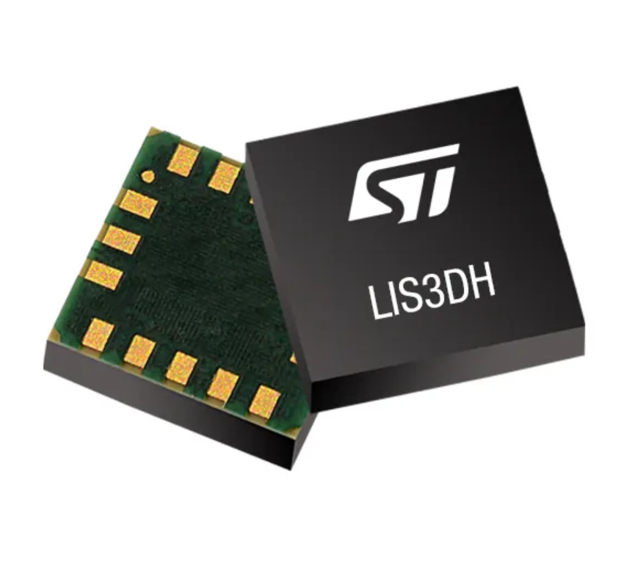
Exercise 1
Meet the LIS3DH
Clone the repository: https://github.com/tweedegolf/workshop-embedded-twoparter
Open your favorite text editor in ‘assignments/part_1’
Open the book and read the intructions
We are going to read the ID register of the chip

Slide 17
Solution
How did you solve it?
What were the problems you encountered?
What did you like or dislike?

Slide 18
Portable drivers
We want drivers for devices
We want them to be portable
Abstraction in C?
Abstraction in Rust?
Low level & high level drivers?
A low level driver
Possibilities in Rust

Slide 19
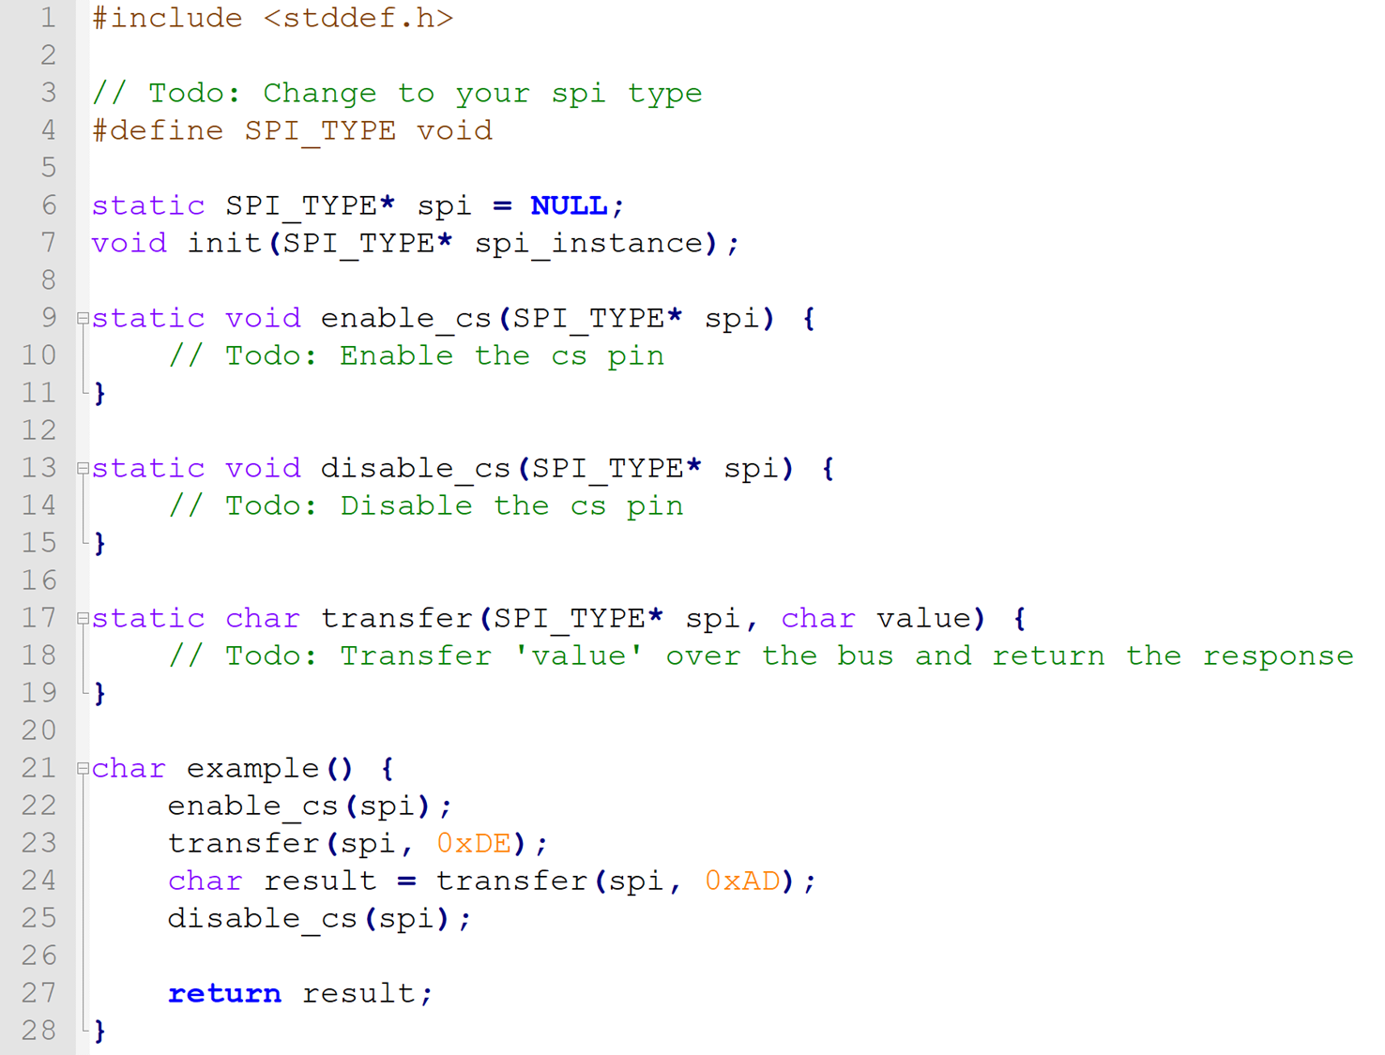
Abstraction in C
Fill-in functions
Efficient
Inconvenient

Slide 20
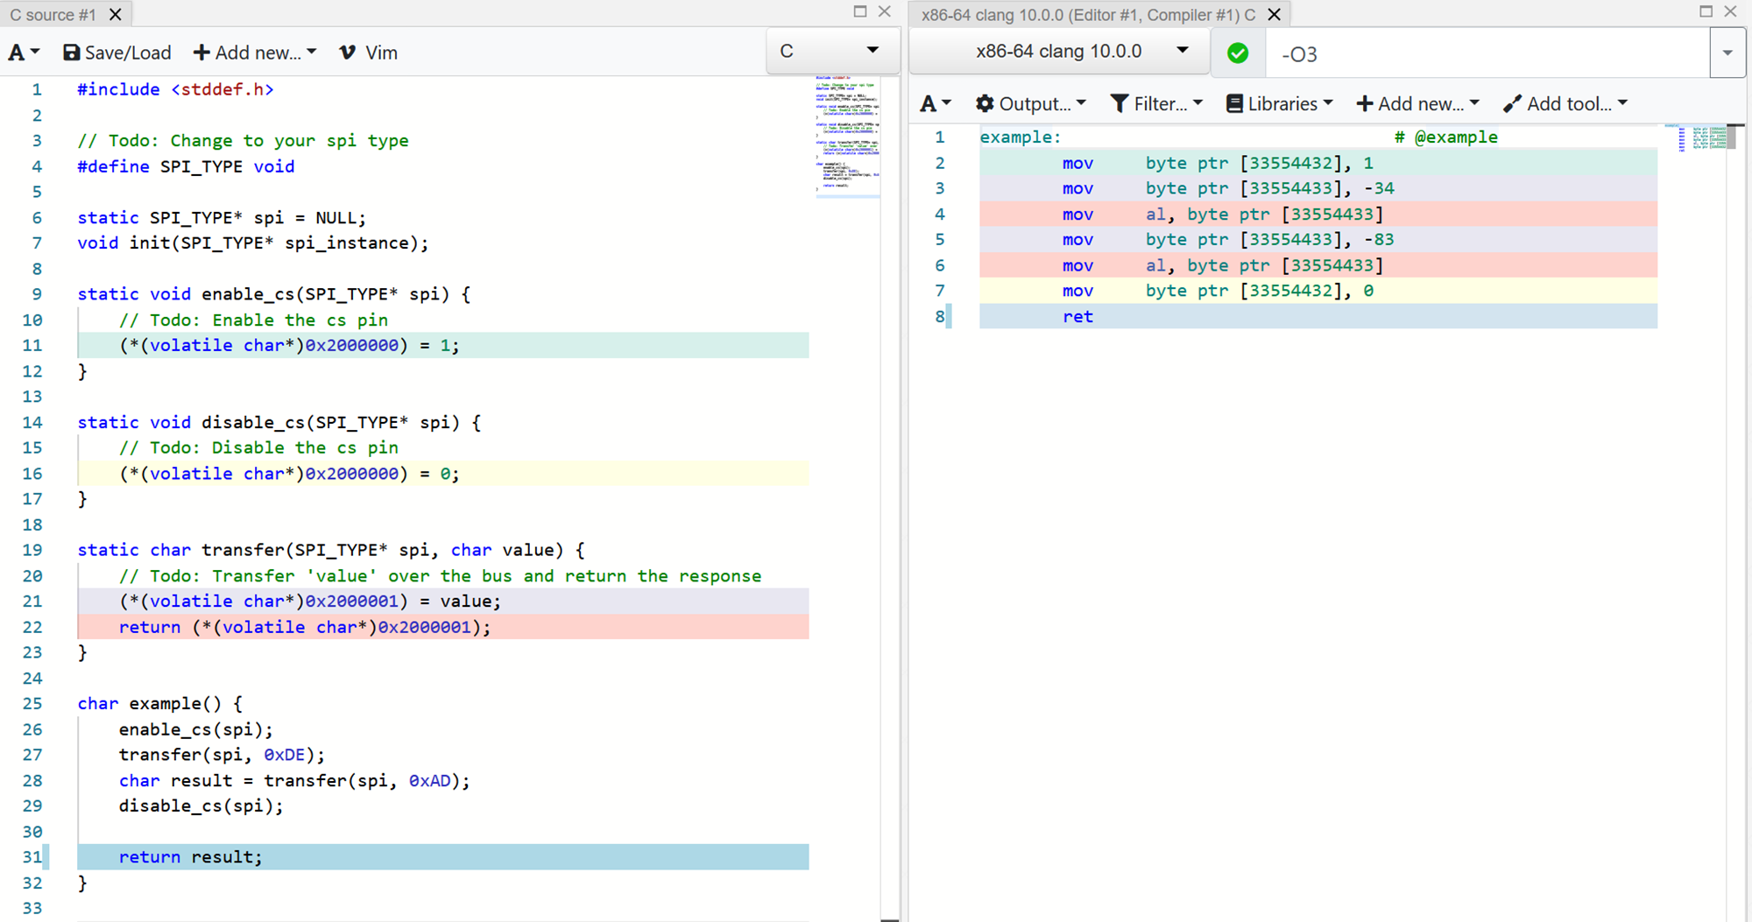

Slide 21
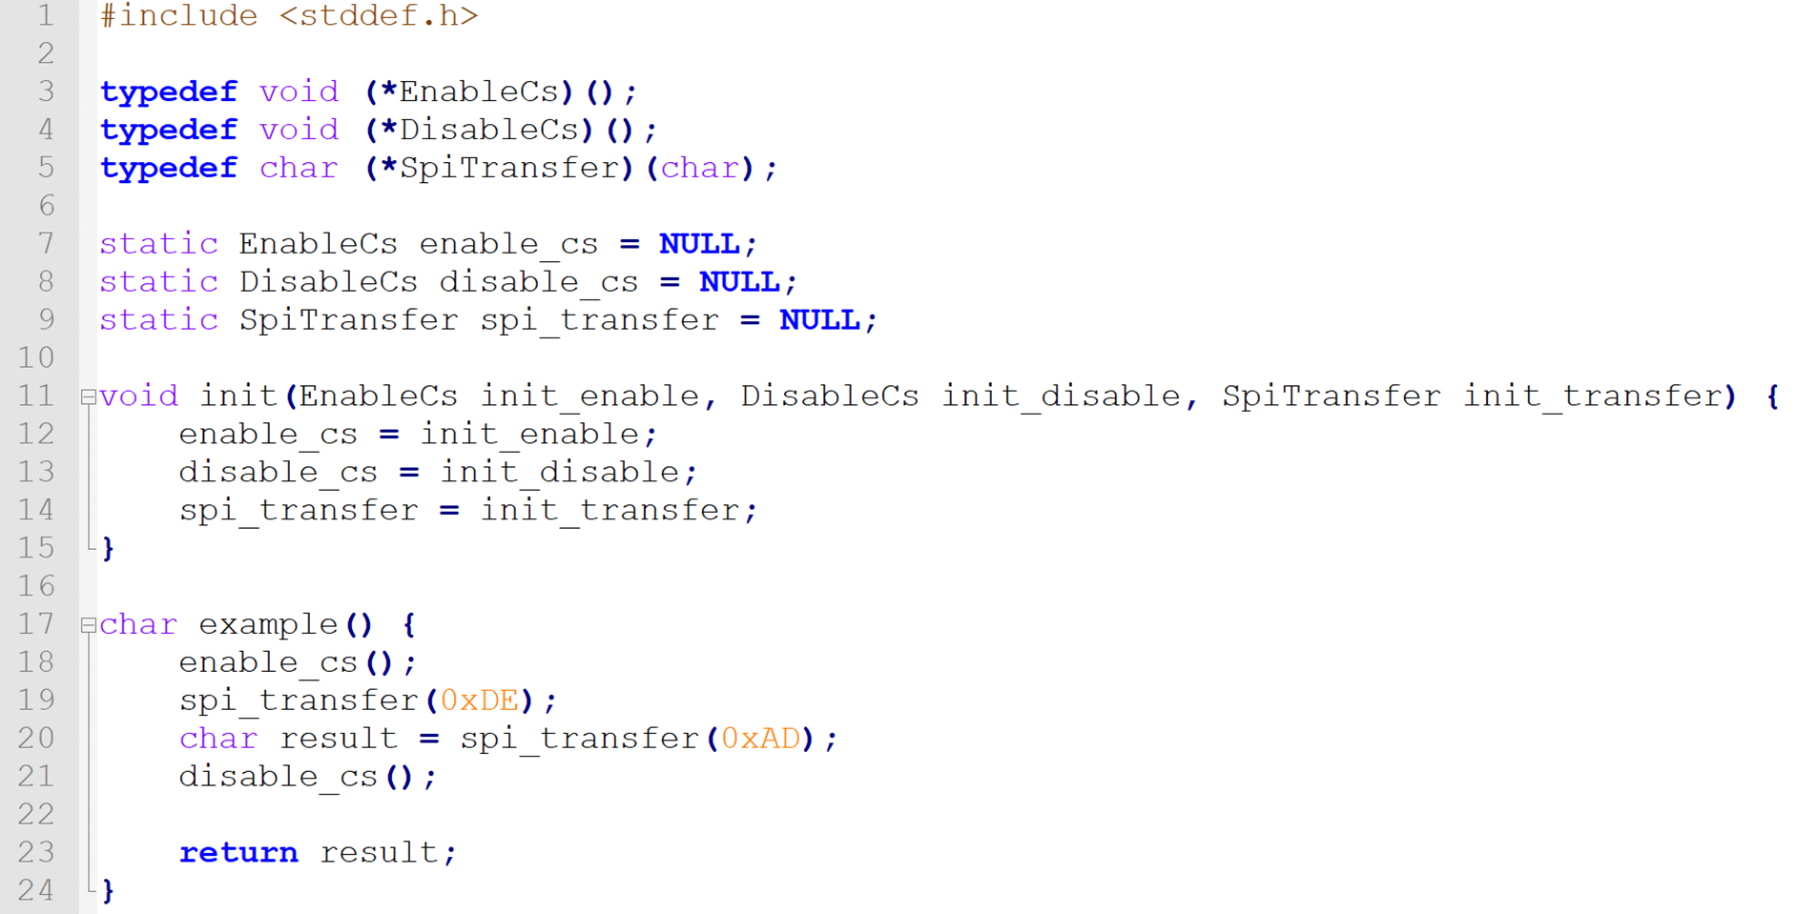
Abstraction in C
Function pointers
Inefficient
Convenient

Slide 22
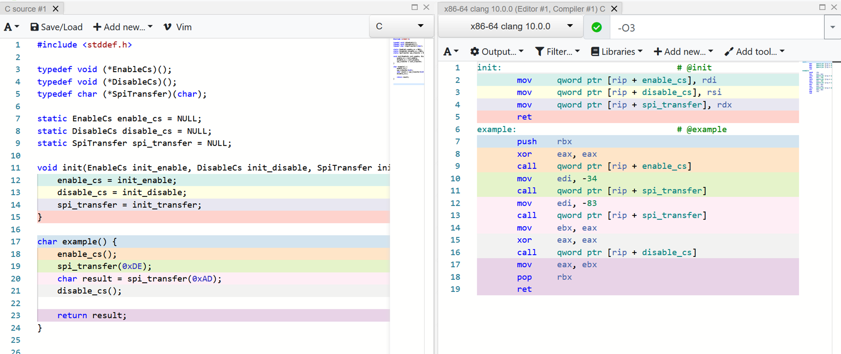

Slide 23
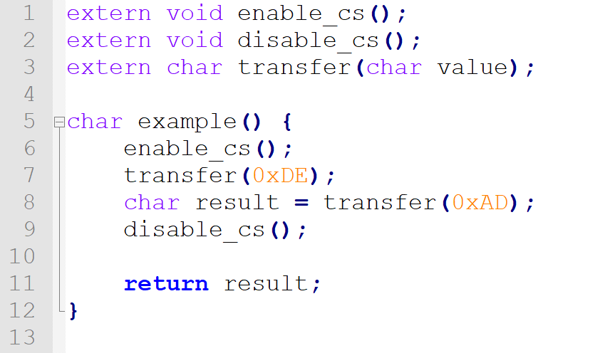
Abstraction in C
Link-time binding
Efficient
Somewhat convenient
Error-prone

Slide 24
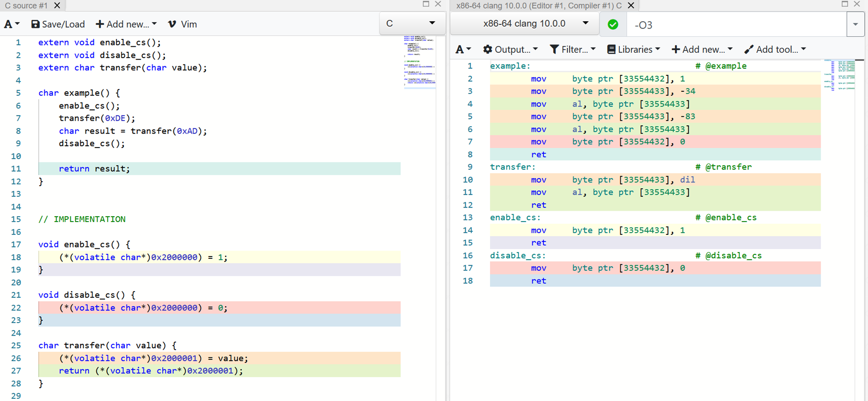

Slide 25
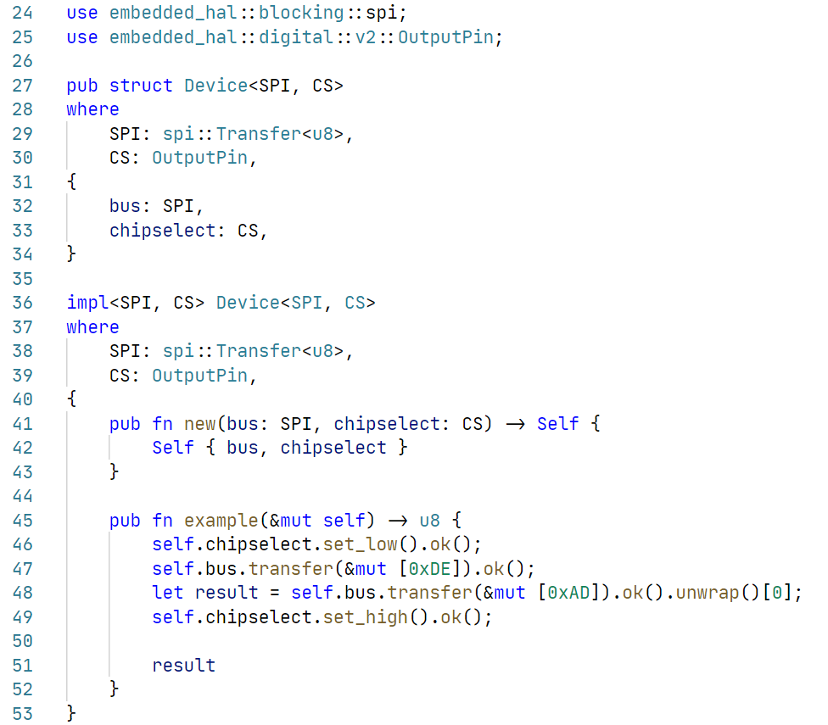
Abstraction in Rust
Traits + generics
Reuse traits from embedded-hal
Efficient
Convenient

Slide 26
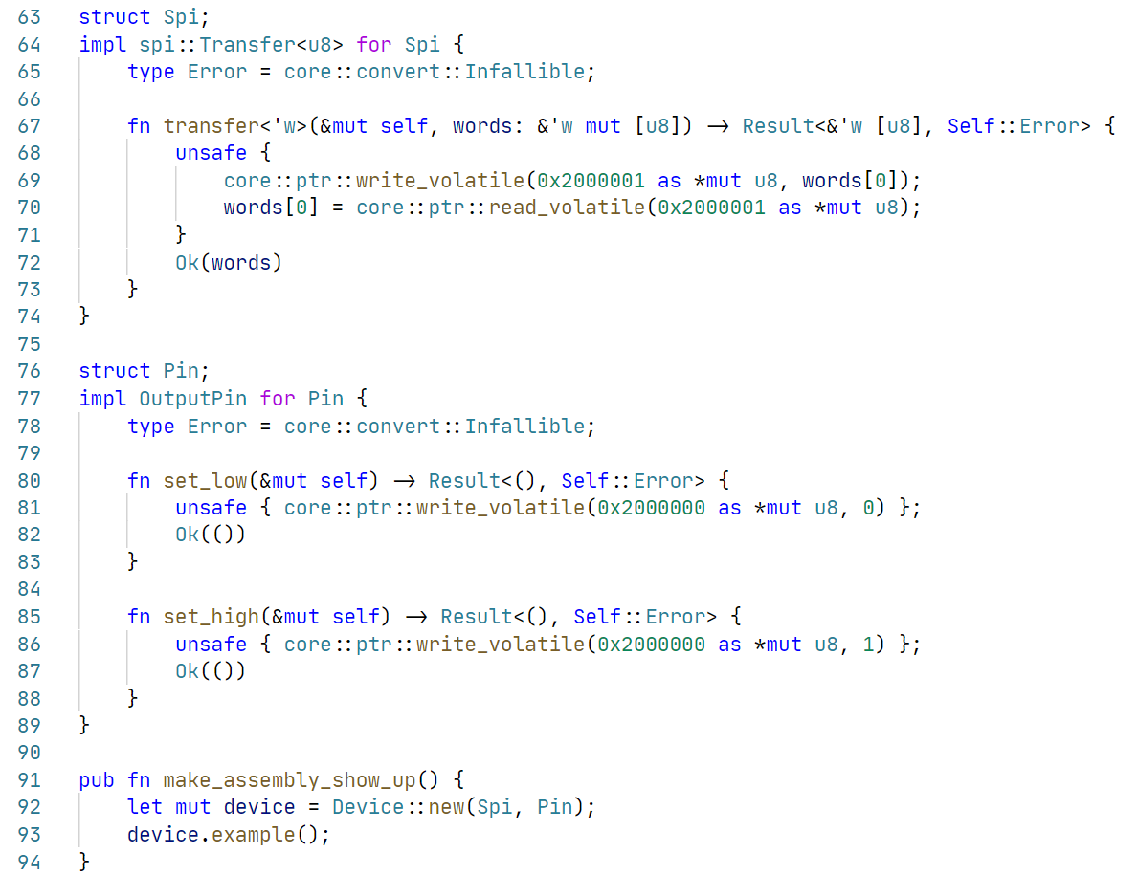
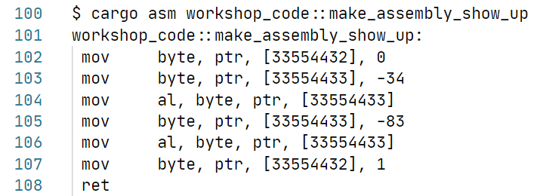

Slide 27
Overview
Driver
embedded-hal
HAL
atsamd
HAL
nrf-hal
HAL
stm32h7xx-hal
HAL
stm32l4xx-hal
PAC
SAMD21E
PAC
nRF9160
PAC
nRF52840
PAC
STM32H743
PAC
STM32H753
PAC
STM32L476
PAC
STM32L496

Slide 28
Low level & high level drivers
Low level driver
Hardware abstractions + reading/writing registers
Register/buffer/command definitions
High level driver
Implement common routines
Requirement assertions
Common interface export

Slide 29
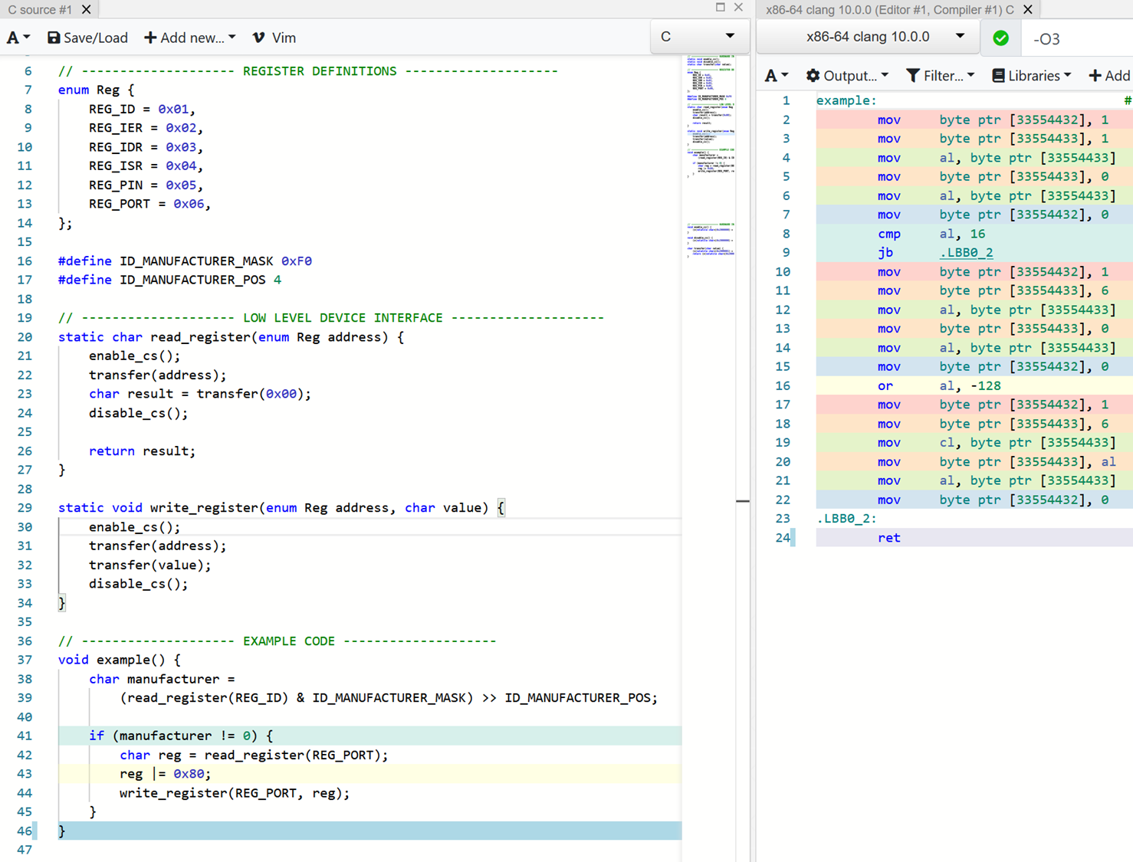
Low level driver in C
Enum & #define for definitions
Functions for read/write

Slide 30
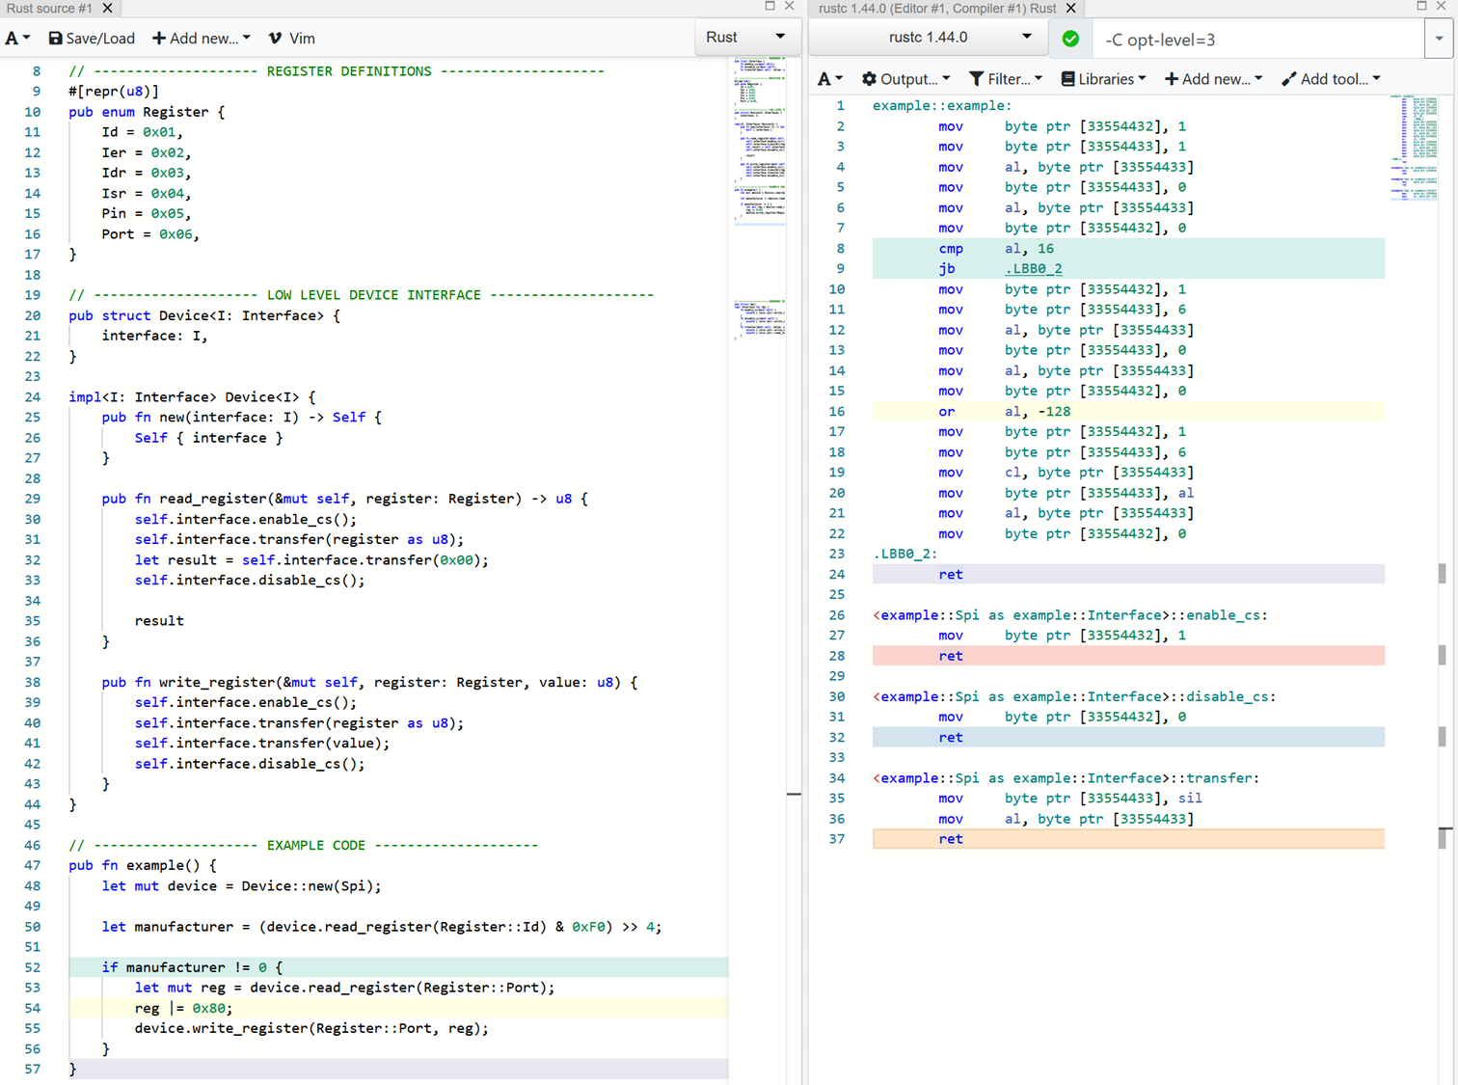
Low level driver in Rust
Enum for definitions
Device struct representing an instance of a chip
Functions for read/write

Slide 31
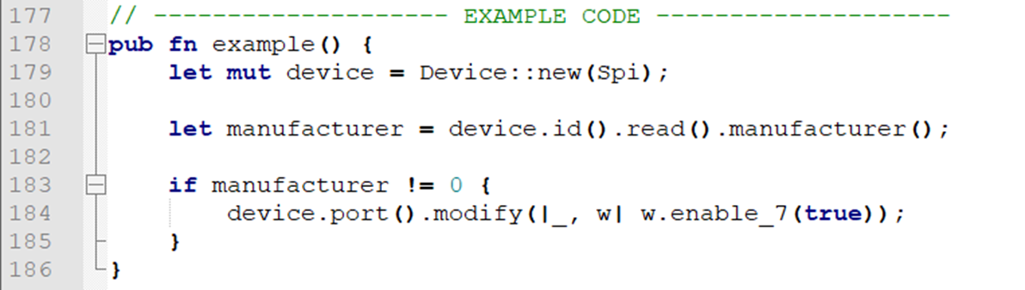
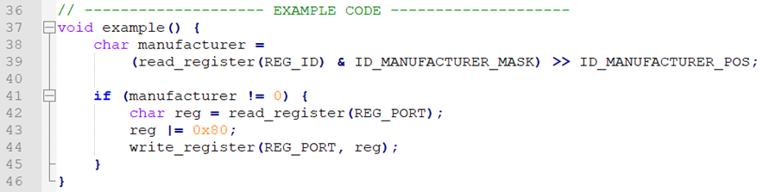
Possibilities in Rust
Much more is possible:

Slide 32
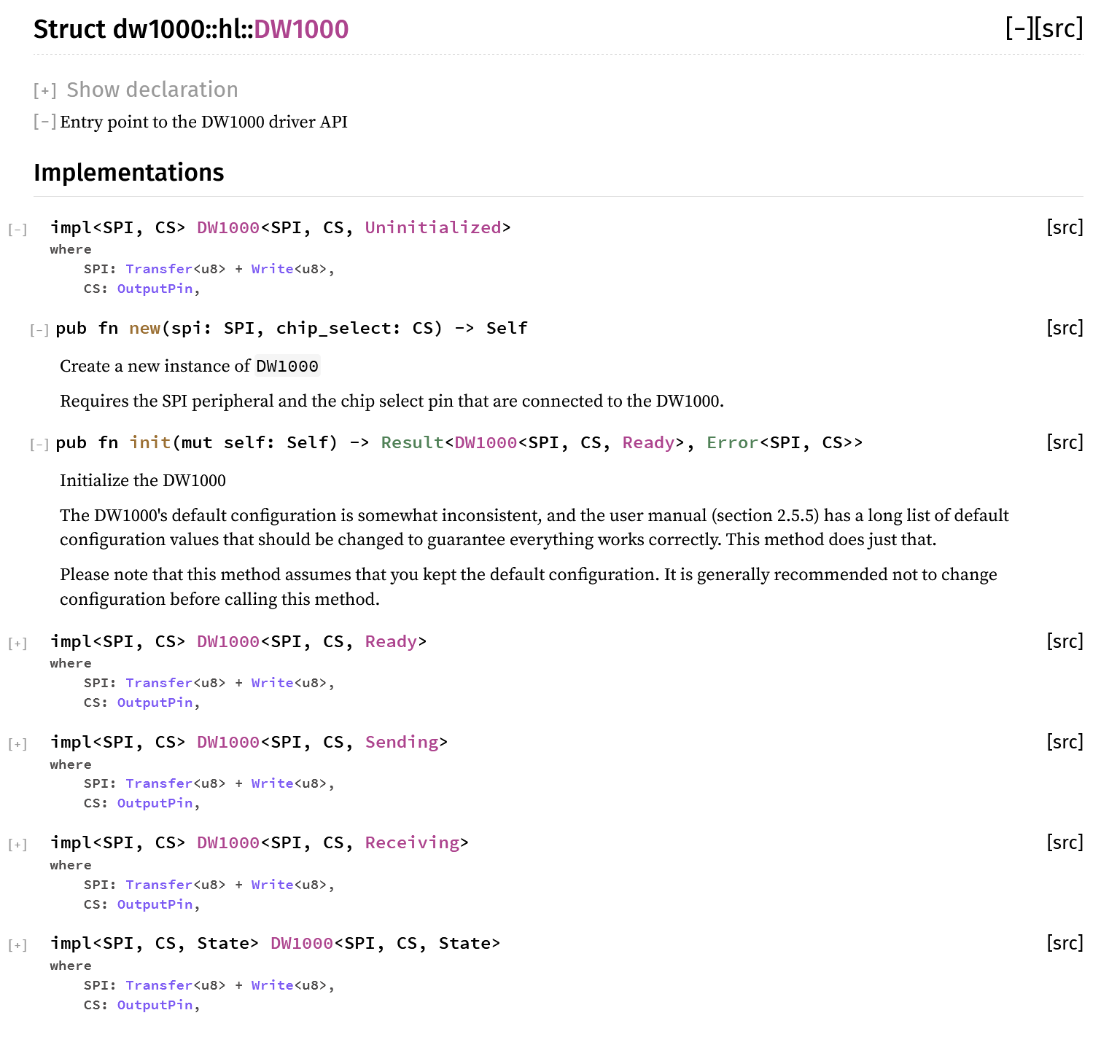
Possibilities in Rust
Add typestate to high level driver

Slide 33
Possibilities in Rust
Much more is possible:
Embedded-hal
Radio
Embedded-nal
Usb-device
Embedded-graphics
Accelerometer
Embedded-storage

Slide 34
Questions so far?
?

Slide 35
Exercise 2
A real driver for the LIS3DH
Open the book and read the intructions

Slide 36
Solution
How did you solve it?
What were the problems you encountered?
What did you like or dislike?

Slide 37

Castellastraat 26, 6512 EX Nijmegen
info@tweedegolf.com
024 3010 484

